Slide 1
MOTION
CLASS-IX

Slide 2
WHAT IS MOTION?
Well, this question has no meaning. Because if you think about it everything is moving.
We have to mention according to who‘s perspective have you asked the question.
The fancy name of this “according to whom” is FRAME OF REFERENCE.

Slide 3
DISTANCE AND DISPLACEMENT
Distance is the LENGTH of the actual path you took i.e. How far did you go.
The direction does not matter.
Displacement is the straight line connecting the starting point and the ending point of your trail.
In this, the direction also matters. (the quantities in which the magnitude as well as the direction matter are called vectors.).

Slide 4
Uniform Motion
It is a term used for motion that has been distributed ‘uniformly’.
It basically means that equal distance is travelled in equal interval of time, no matter how small a time interval it is.

Slide 5
SPEED
Speed is the DISTANCE that is travelled in one unit of time (it can be any unit).
So how will you find speed?
You will just devide the distance by the time!

Slide 6
VELOCITY
Velocity is the DISPACEMENT that is travelled in one unit of time (it can be any unit).
So how will you find velocity?
You will devide the DISPLACEMENT by the time.

Slide 7
Velocity vs. Speed
A thing that confuses many

Slide 8
ACCELERATION
It is the rate of change of VELOCITY.

Slide 9
We visualise motion using these line graphs:

Slide 10
Dispalcement-Time Graph
This type of graph shows the change of displacement over time i.e. velocity

Slide 11
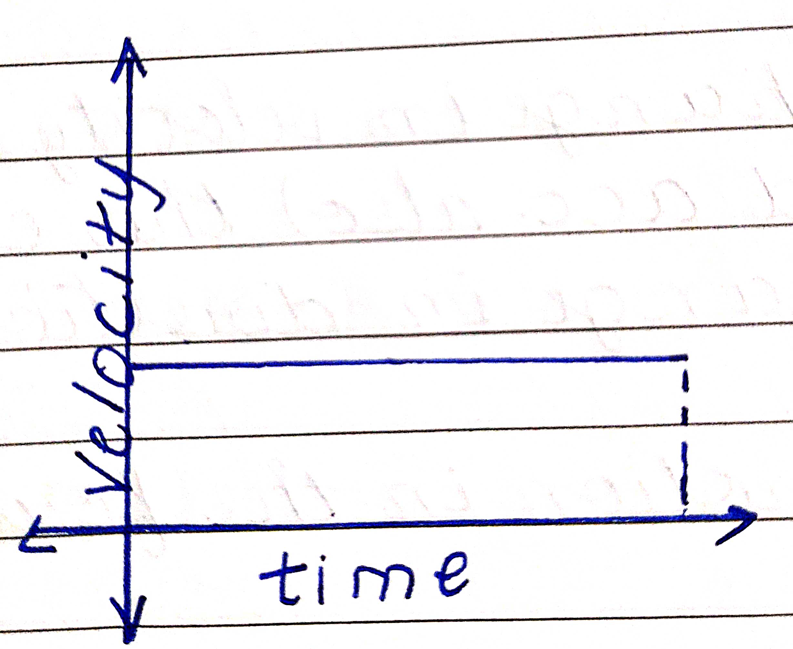
Velocity-Time Graph
Shows change in acceleration.

Slide 12
Equations of Motion

Slide 13
Conditions on the equations of motion

Slide 14
Equation 1
let v = initial velocity, let a = acceleration
let u = final velocity and let t = time
a = (v-u)/t
=> v-u = at (cross-multiplication)
therefore, v = at + u
And that is the first equation of motion

Slide 15
If the acceleration of a passenger jet is 14 m/s², how much will its velocity have changed in 15 seconds?
to find: v-u (change in velocity)
a = 14 m/s², t = 15 seconds
v-u = at
v-u = 14 * 15
v-u = 210
therefore velocity will have changed by 210 m/s

